Slide 1
Media Arts Department
Spring 2020 Awards

Slide 2
BEST SCREENPLAY

Slide 3
Honorable mention
MEAT CUTE
MEGAN MILO

Slide 4
Honorable mention
INFINITY PLUS ONE
AZAD AZIZYAN

Slide 5
3rd place
LA FILLE
AMANDA FARIES

Slide 6
2nd place
SPARKS FLY
CYNTHIA HERNANDEZ

Slide 7
First place
W.A.S.P.
RACHEL REPSHAS

Slide 8
BesT PAGE DESIGN

Slide 9
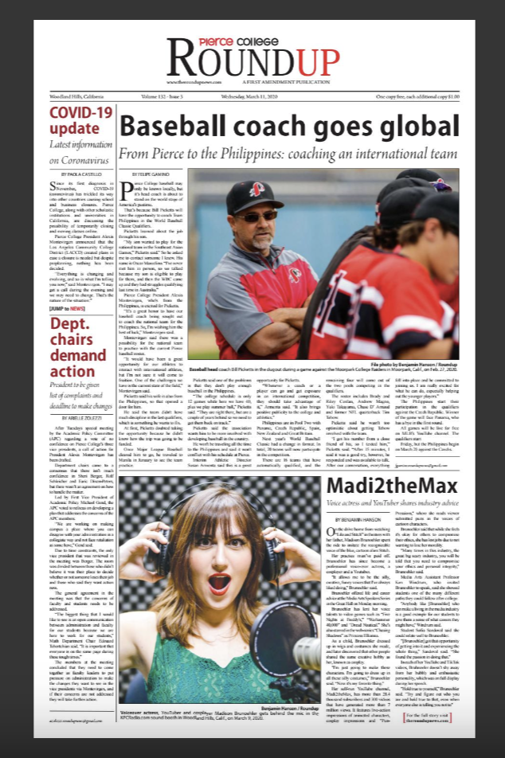
Honorable mEntion
ISSUE 3 PAGE ONE
Katya castillo

Slide 10
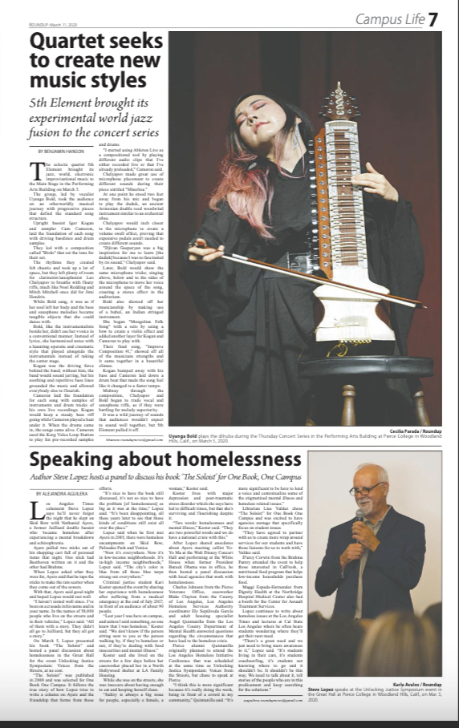
3rd place
ISSUE 3, PAGE 7
Angelica lopez

Slide 11
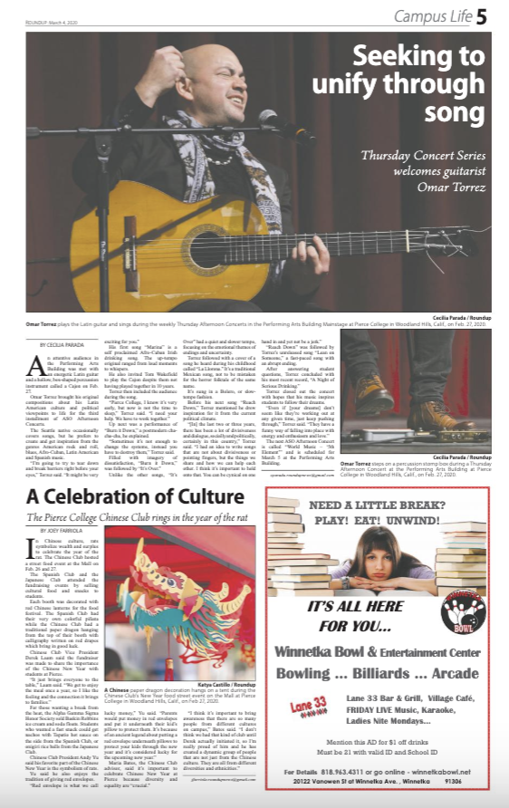
2nd place
ISSUE 2, PAGE 5
Angelica lopez

Slide 12
First place
KATYA CASTILLO
ISSUE 4, PAGE 1

Slide 13
Best editorial

Slide 14
Honorable mEntion
THE IMPORTANCE OF VOTER TURNOUT

Slide 15
3rd place
MOVE ALL DEADLINES TO THE END OF A SEMESTER

Slide 16
2nd place
STUDENT ZOOM time

Slide 17
First place
WEEKLY CLASS WEBINAR

Slide 18
Best Feature/L.A. LIfe

Slide 19
Honorable mEntion
Rain or shine or pandemic
by Katya Castillo

Slide 20
Honorable mention
Bringing magic into the classroom
by Joey Fariola

Slide 21
3rd place
Pierce students balance being essential workers
By Shehreen Karim

Slide 22
2nd place
Pierce student wins scholarship
by Katya Castillo

Slide 23
First place
Speaking Out for Homelessness
By Alejandra Aguilera

Slide 24
Opinion

Slide 25
3rd place
Bittersweet farewell
By Giselle Ormeno

Slide 26
2nd place
Not Sick, just Asian
by Peter villafane

Slide 27
First place
Definition Doesn’t Determine Validity
By Paola Castillo

Slide 28
Best Feature/L.A. LIfe Photo

Slide 29
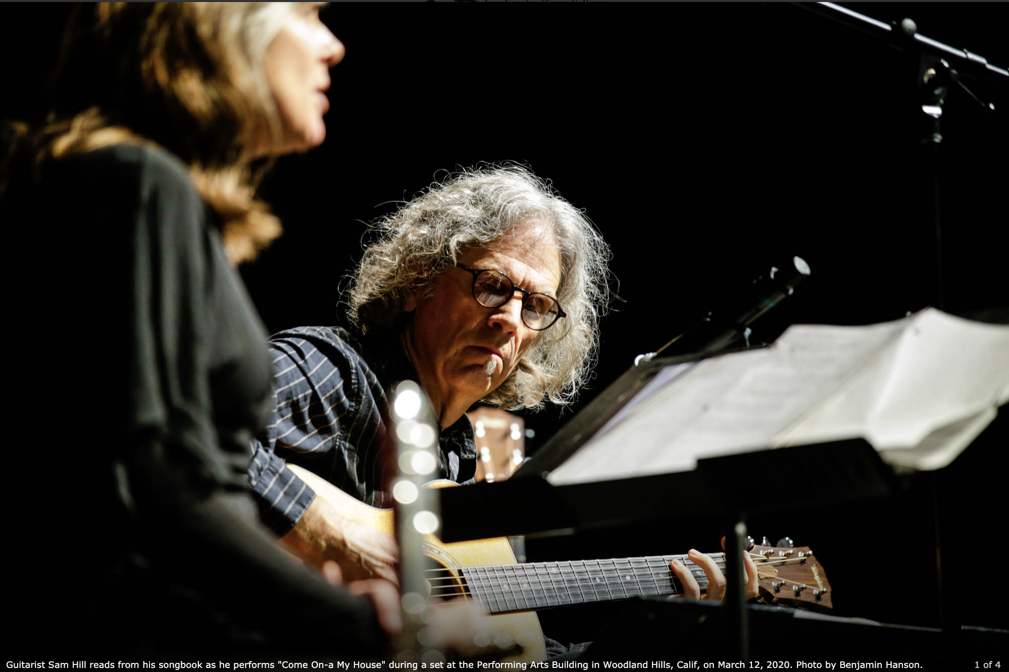
Honorable mention
Duo closes out
Thursday concert series
Ben Hanson

Slide 30
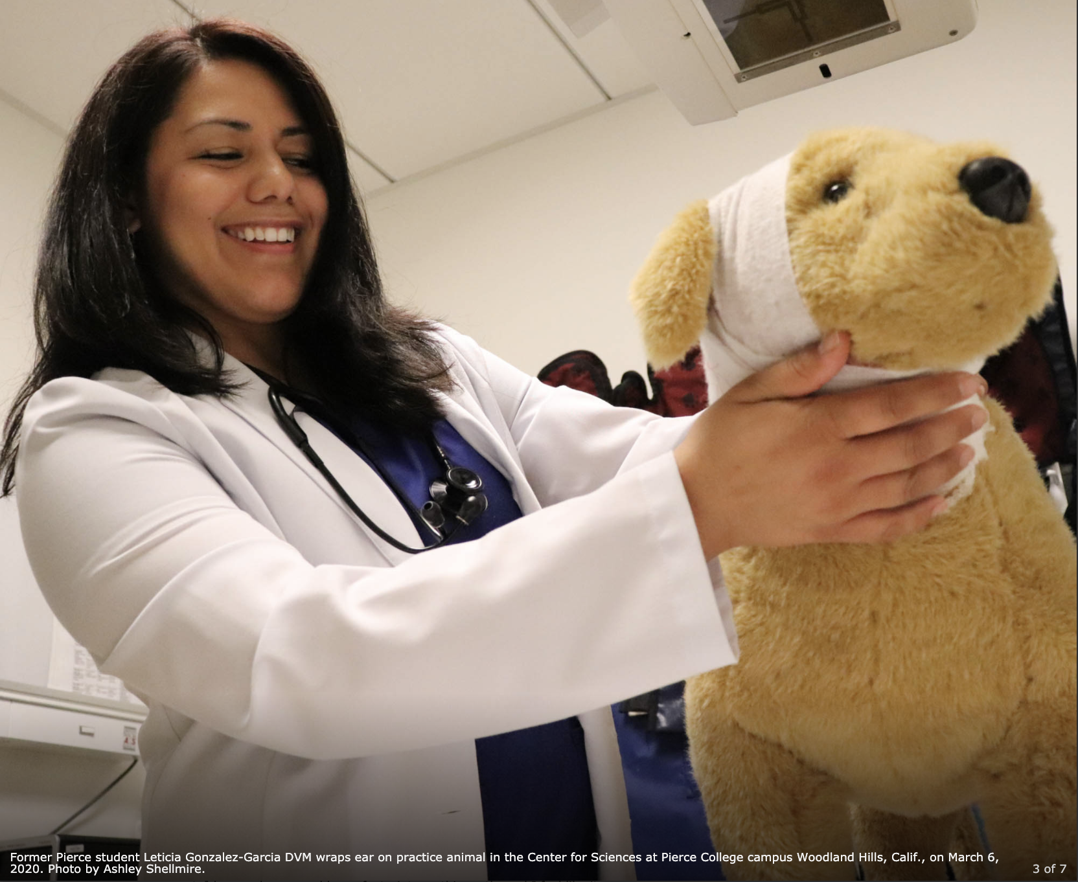
Honorable mention
Her love for giving back as a pierce college alumna
by Ashley Shellmire

Slide 31
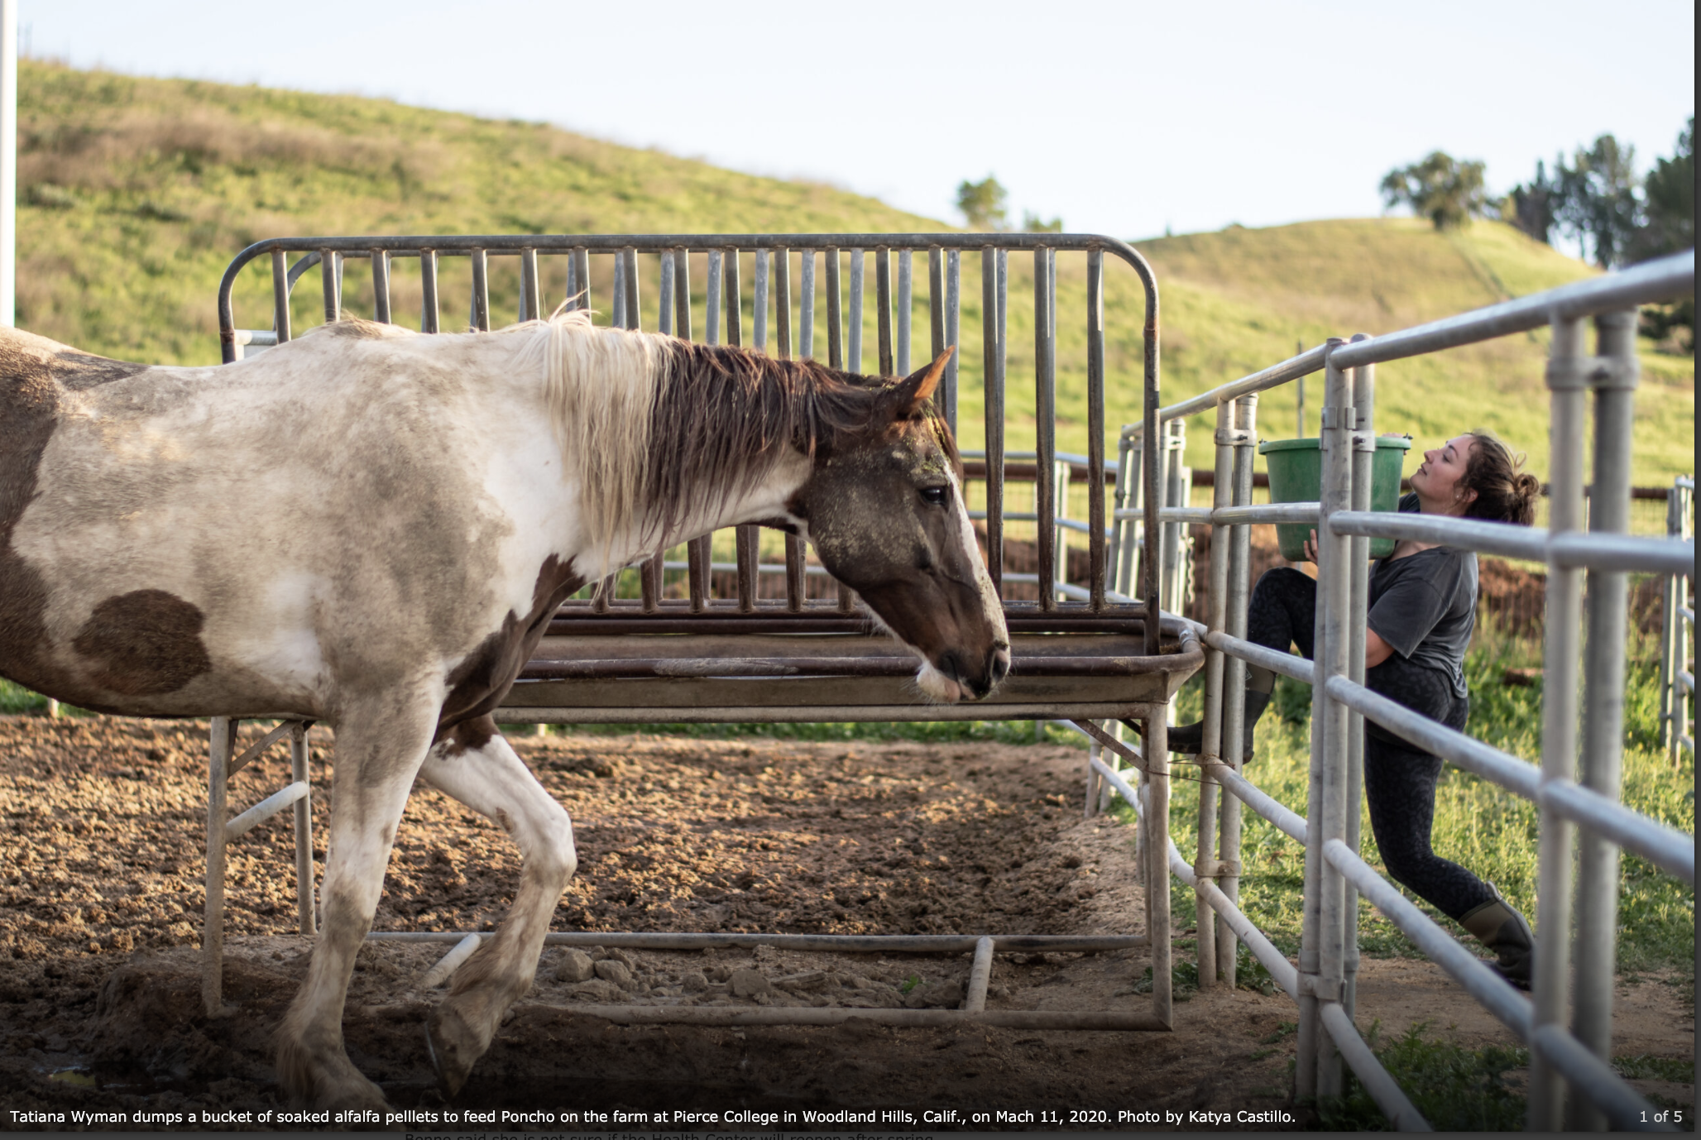
3rd place
Parts of pierce still operational
By Katya castillo

Slide 32
2nd place
Madi to the Max
by Ben Hanson

Slide 33
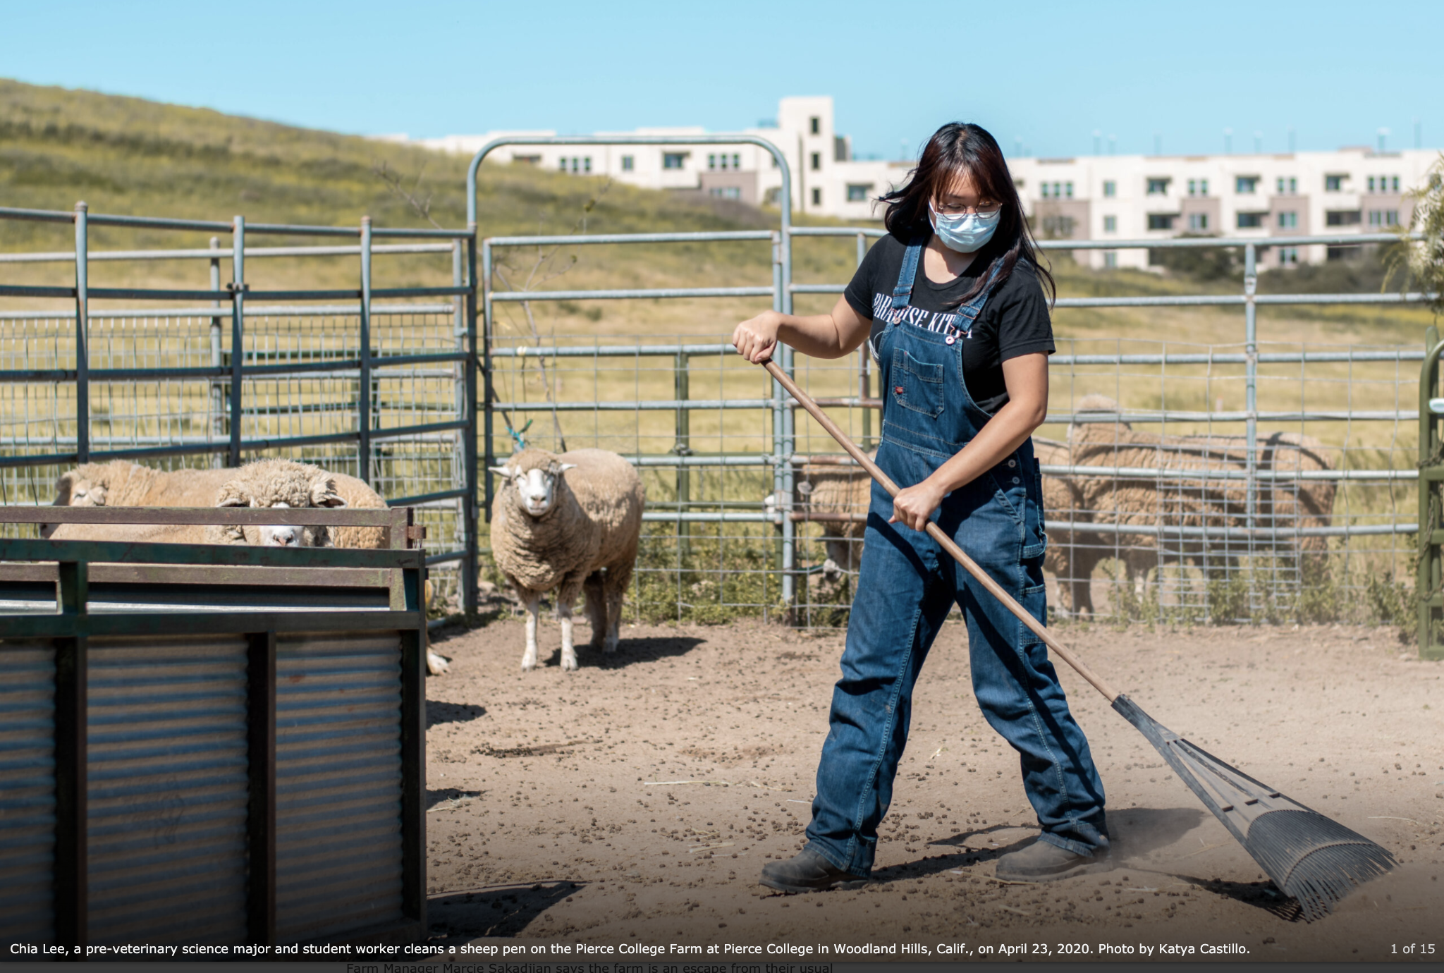
Rain, Shine or Pandemic
By Katya Castillo
First place

Slide 34
Best News article

Slide 35
Honorable
Mention
Class crisis, Confidence shaken
By Arielle Zolezzi

Slide 36
Honorable
Mention
Health fee increase
By Joey Fabiola

Slide 37
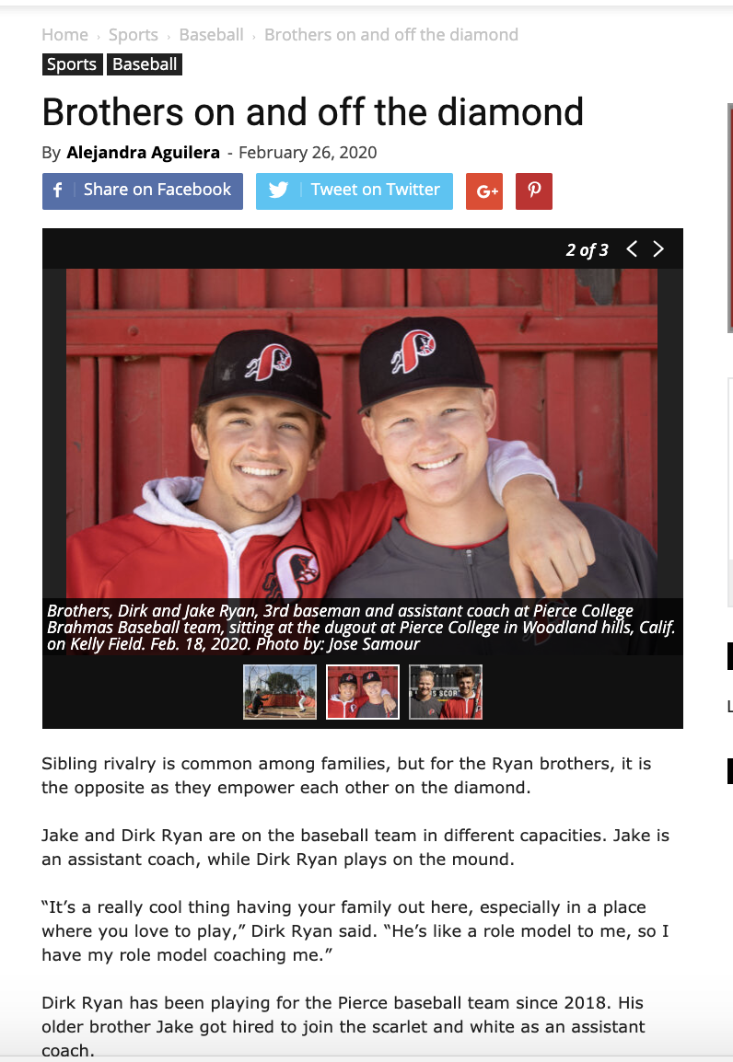
3rd place
Brothers on and off the diamond
By Alejandra Aguilera

Slide 38
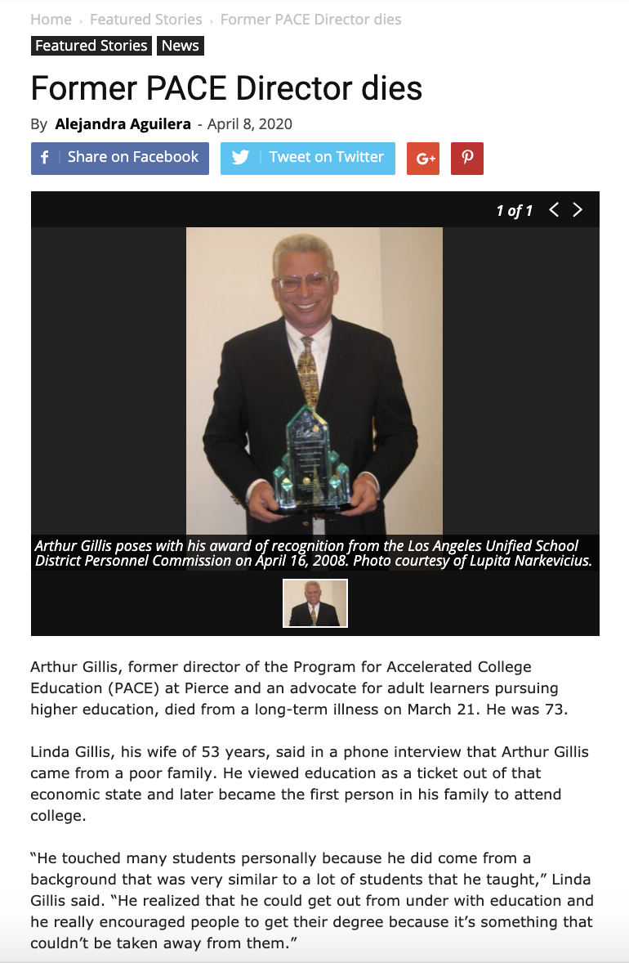
2nd place
Former pace director dies
by Alejandra Aguilera

Slide 39
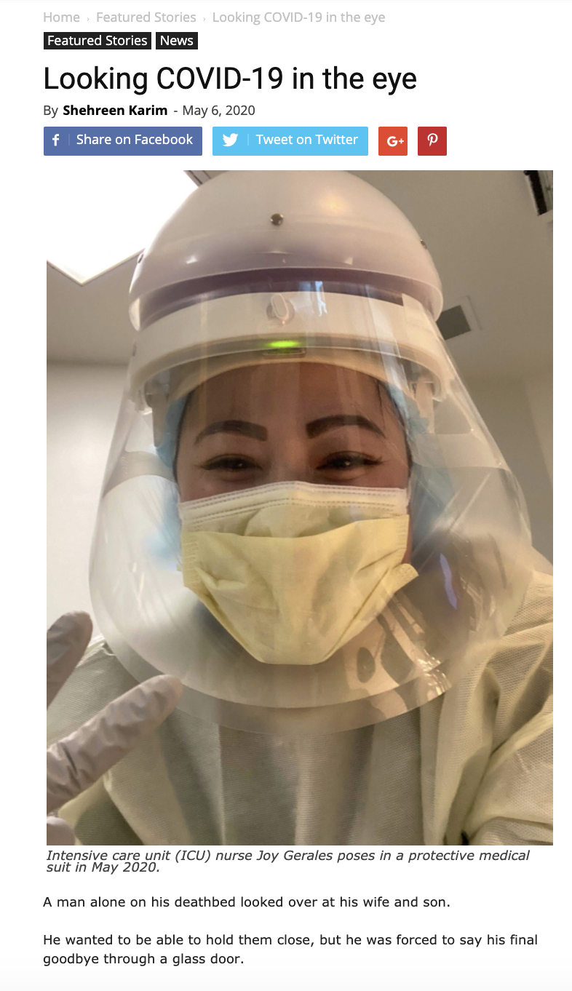
First place
Looking Covid-19 in the Eye
By Shehreen Karim

Slide 40
Best magazine story

Slide 41
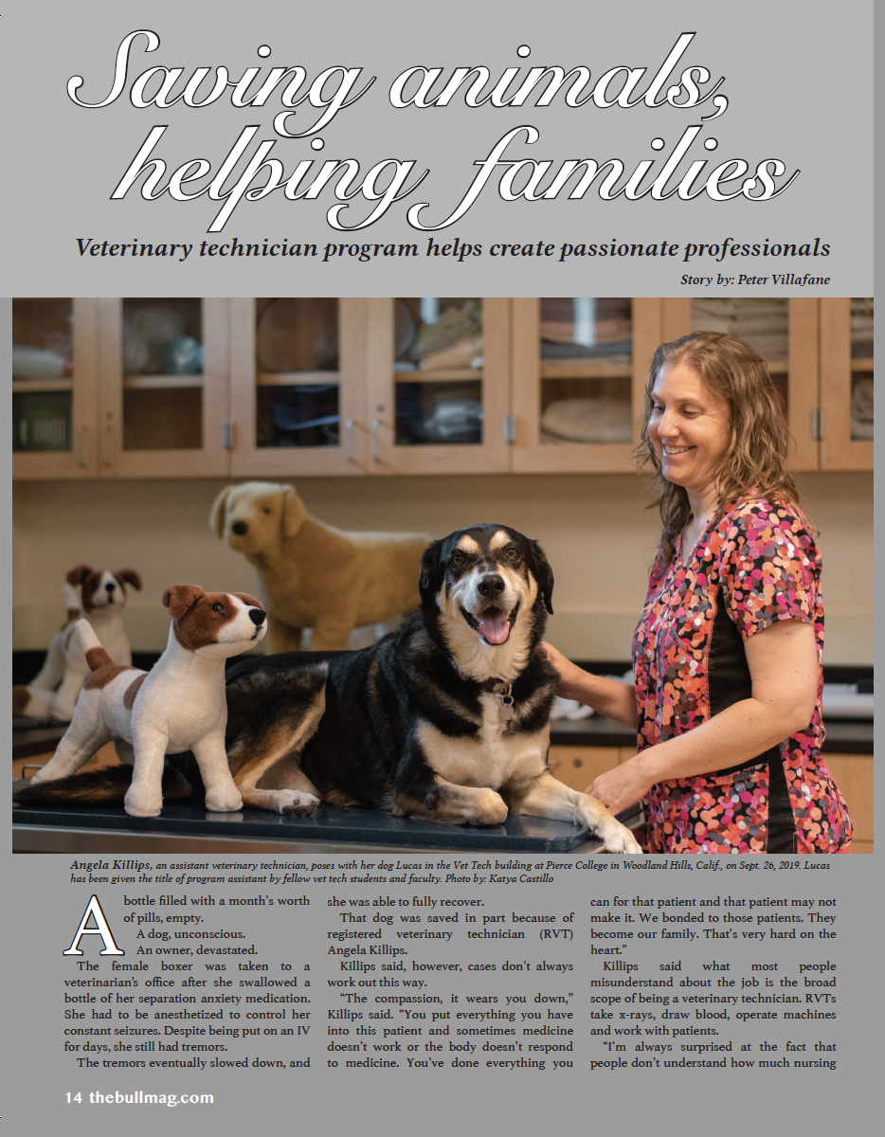
3rd place
Saving animals, helping families
By Peter villafane

Slide 42
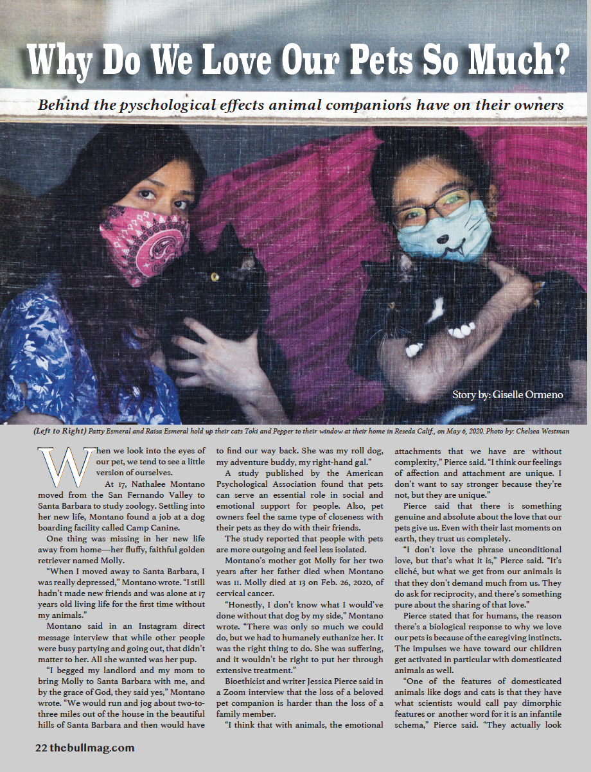
2nd place
WHY DO WE LOVE OUR PETS SO MUCH
BY GISELLE ORMENO

Slide 43
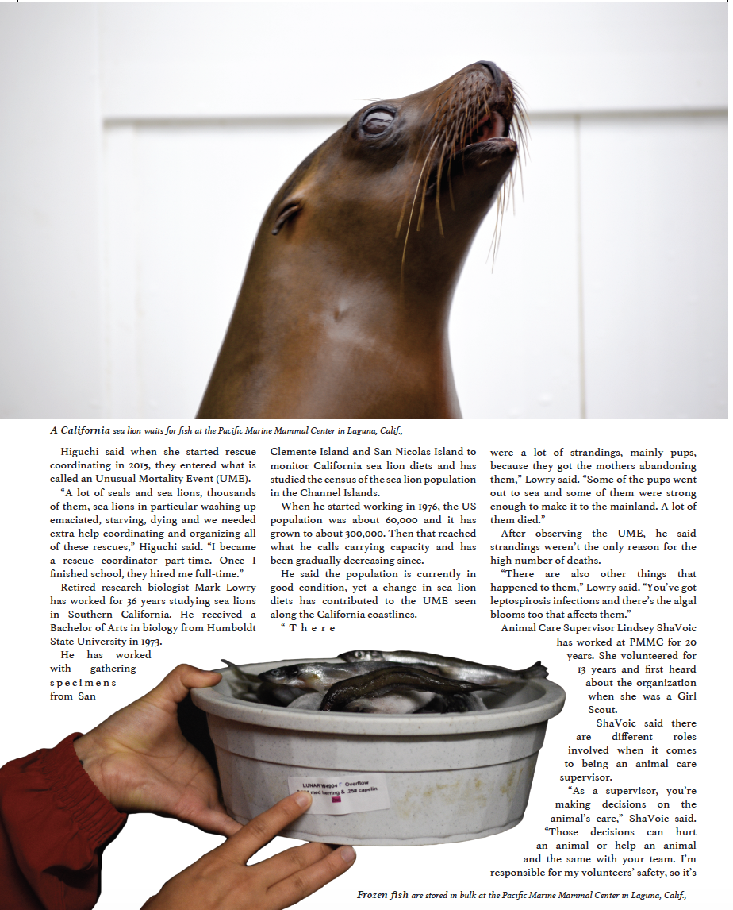
First place
RESCUE, REHABILITATE, RELEASE
By CHELSEA WESTMAN

Slide 44
Best magazine Photo

Slide 45
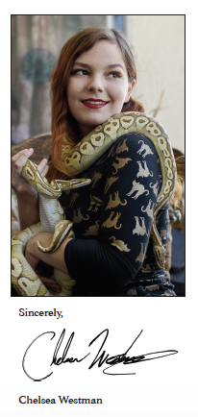
Honorable mEntion
Selfie with snake
by Chelsea Westman

Slide 46
Honorable mEntion
Selfie with dog
by Adam Baron

Slide 47
4th place
Ronald Johnson with snake
by Atena Naghi

Slide 48
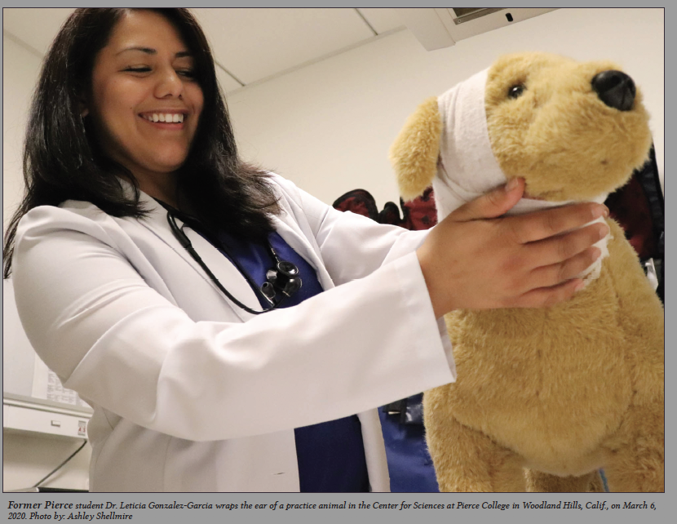
3rd place
Dr. gonzalez-garcia
By Ashley Shellmire

Slide 49
2nd place
saskia with Guinea Pig
by Chelsea Westman

Slide 50
First place
Dog with Mask
By Adam Baron

Slide 51
Best magazine
Photo Story

Slide 52
3rd place
Without a home, but not alone
By Atena Naghi

Slide 53
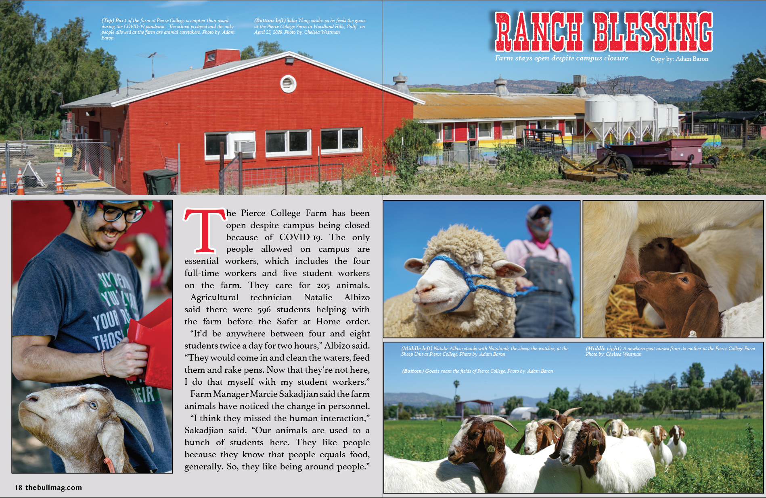
2nd place
Ranch blessings
By Adam Baron and
Chelsea Westman

Slide 54
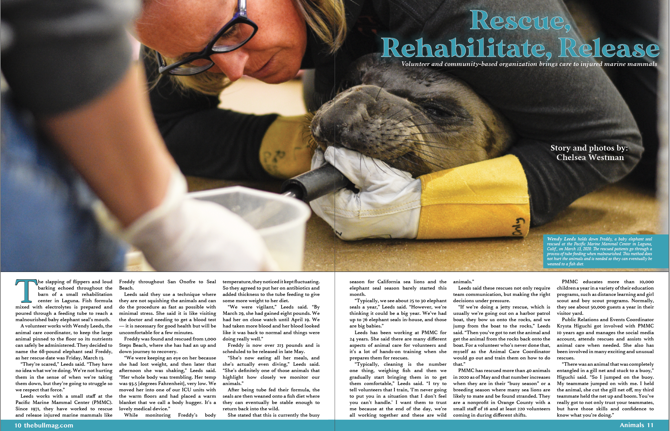
Seal Rescue
By Chelsea Westman
First place

Slide 55
Best portrait

Slide 56
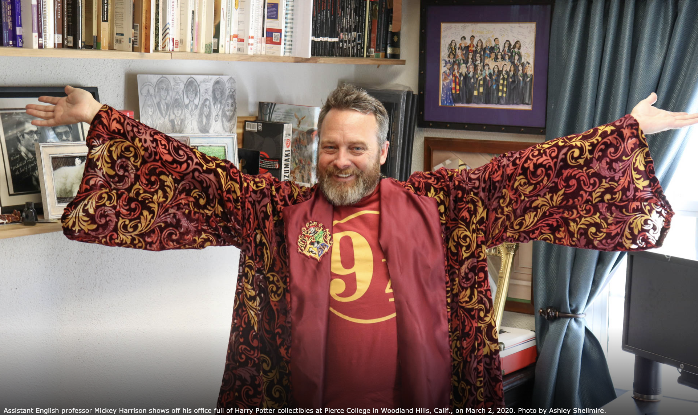
Honorable
Mention
BRINGING MAGIC TO THE CLASSROOM
By ASHLEY SHELLMIRE

Slide 57
3rd place
BRINGING MEANING THROUGH MUSIC
By JOSHUA PRICE

Slide 58
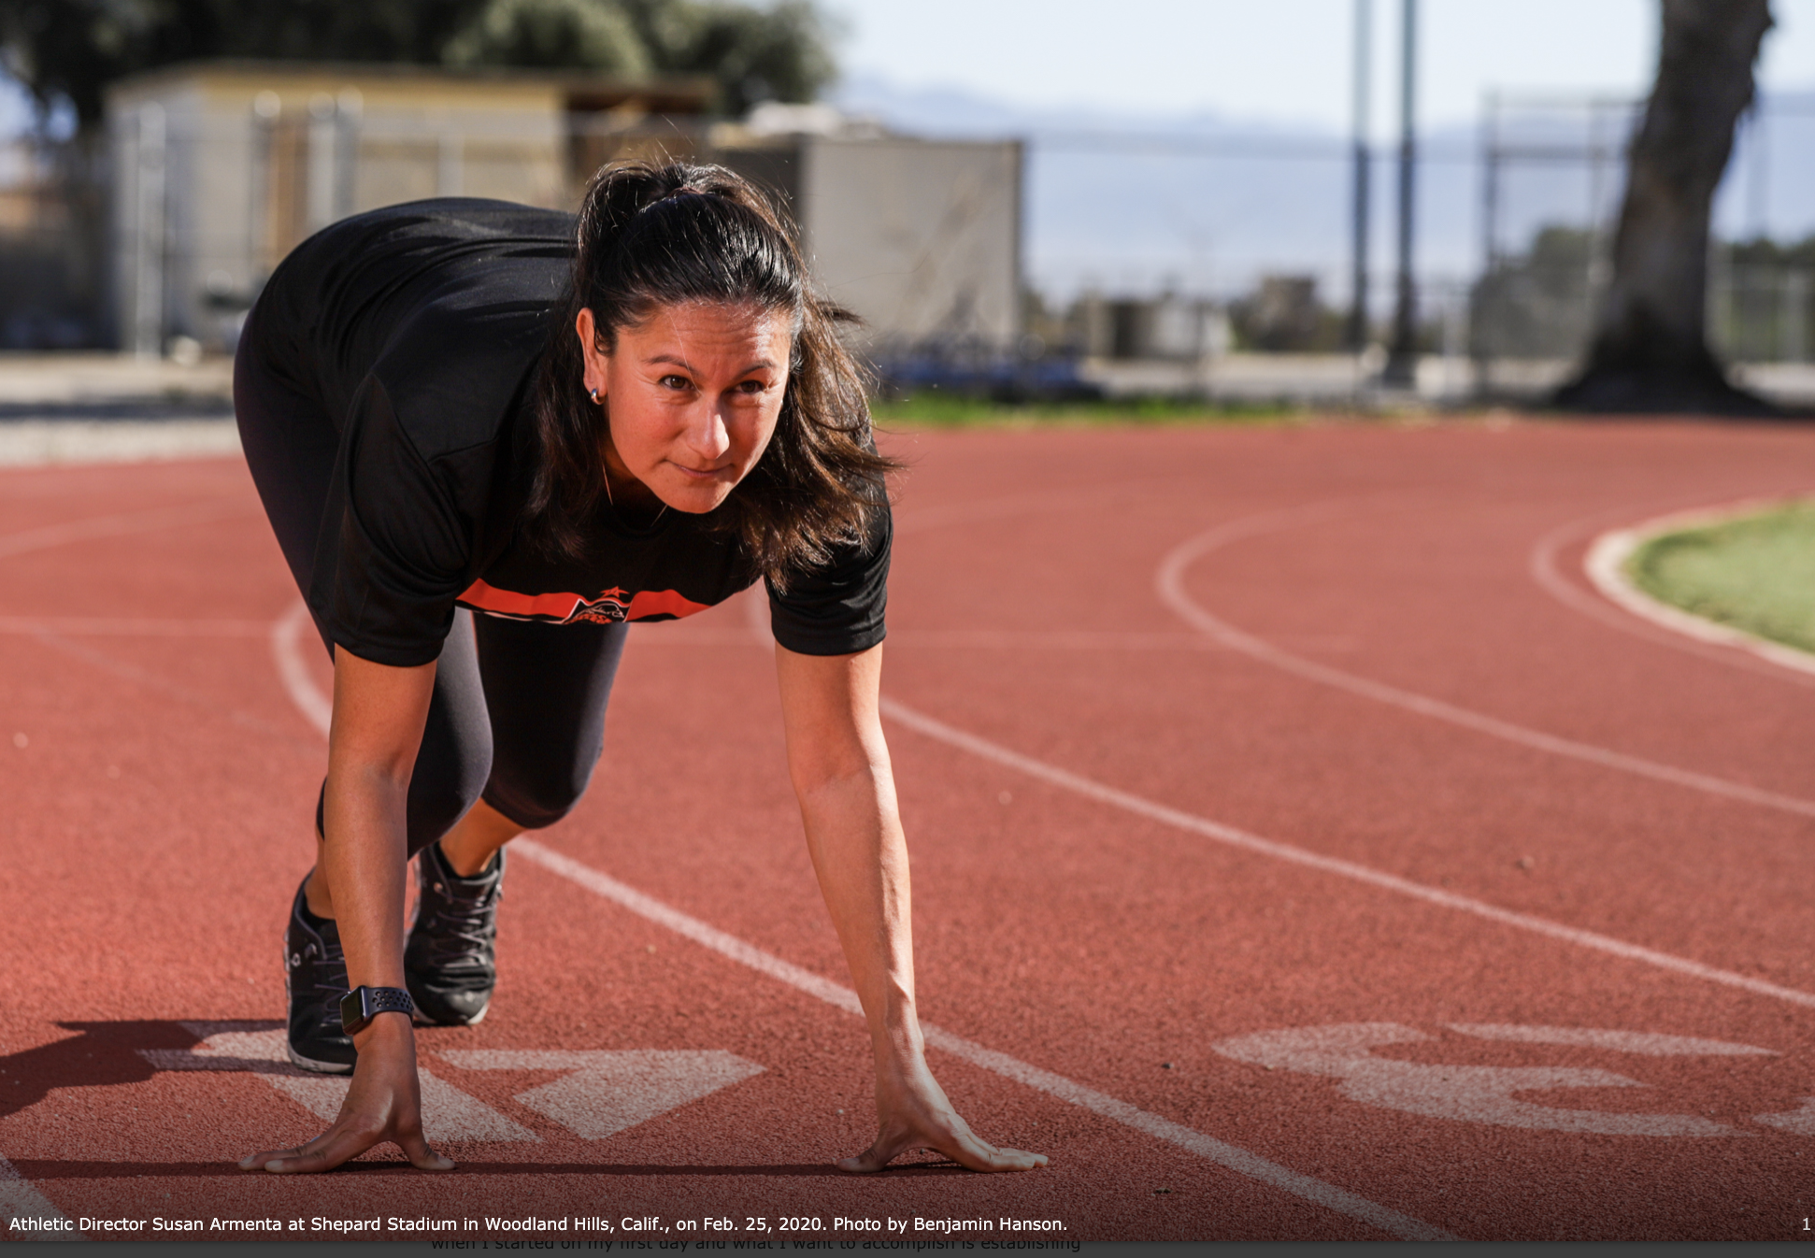
2nd place
NEW INTERIM ATHLETIC DIRECTOR
by BENJAMIN HANSON

Slide 59
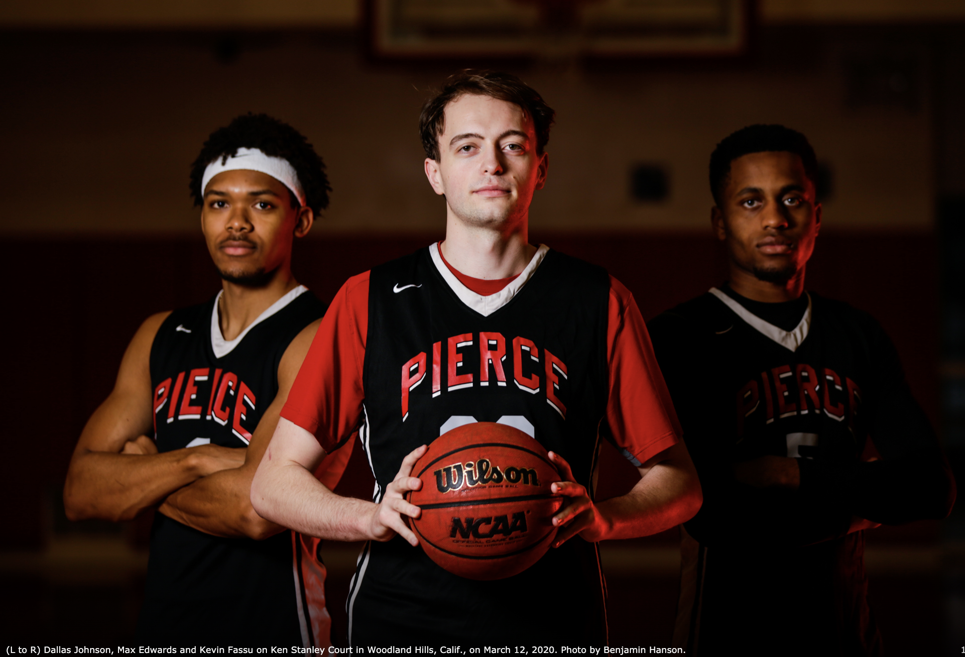
First place
RECEIVING ALL CONFERENCE RECOGNITION
BY BENJAMIN HANSON

Slide 60
Best PHOTO ESSAY

Slide 61
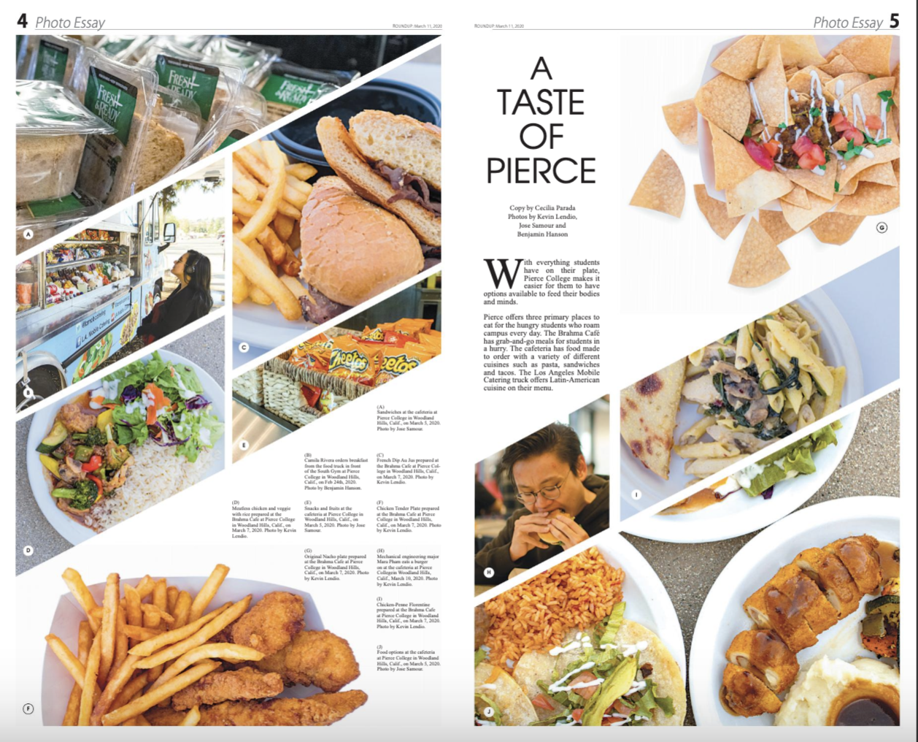
Honorable
Mention
A taste of pierce
By ben hanson,
Kevin lendio,
And Jose samour

Slide 62
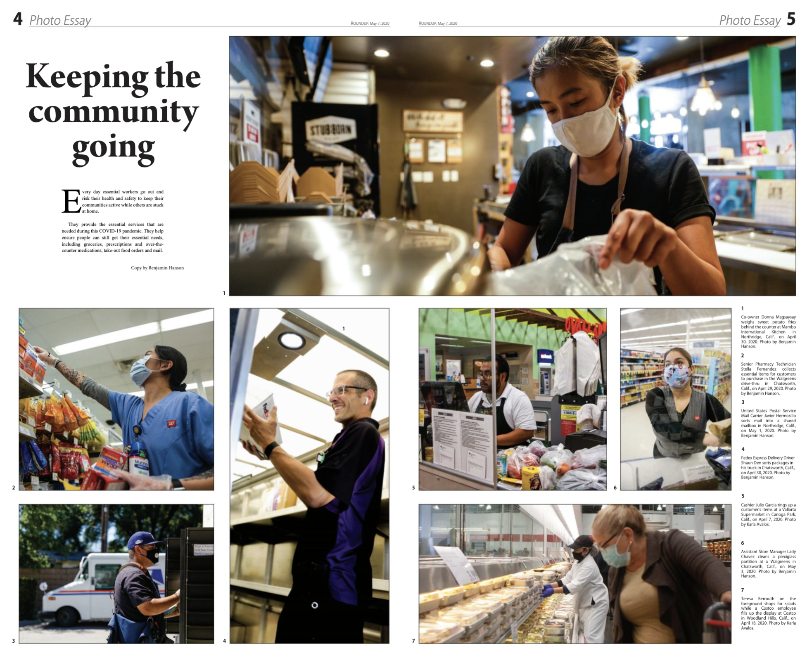
3rd place
Keeping THE
Community GOING
By karla avalos
AND BEN HANSON

Slide 63
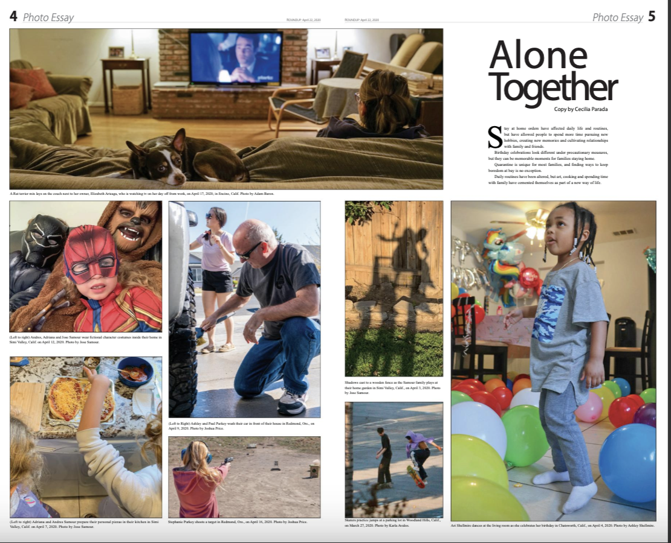
2nd place
Alone together
By Karla avalos, Adam baron, Joshua price, Jose Samour, and Ashley shellmire,

Slide 64
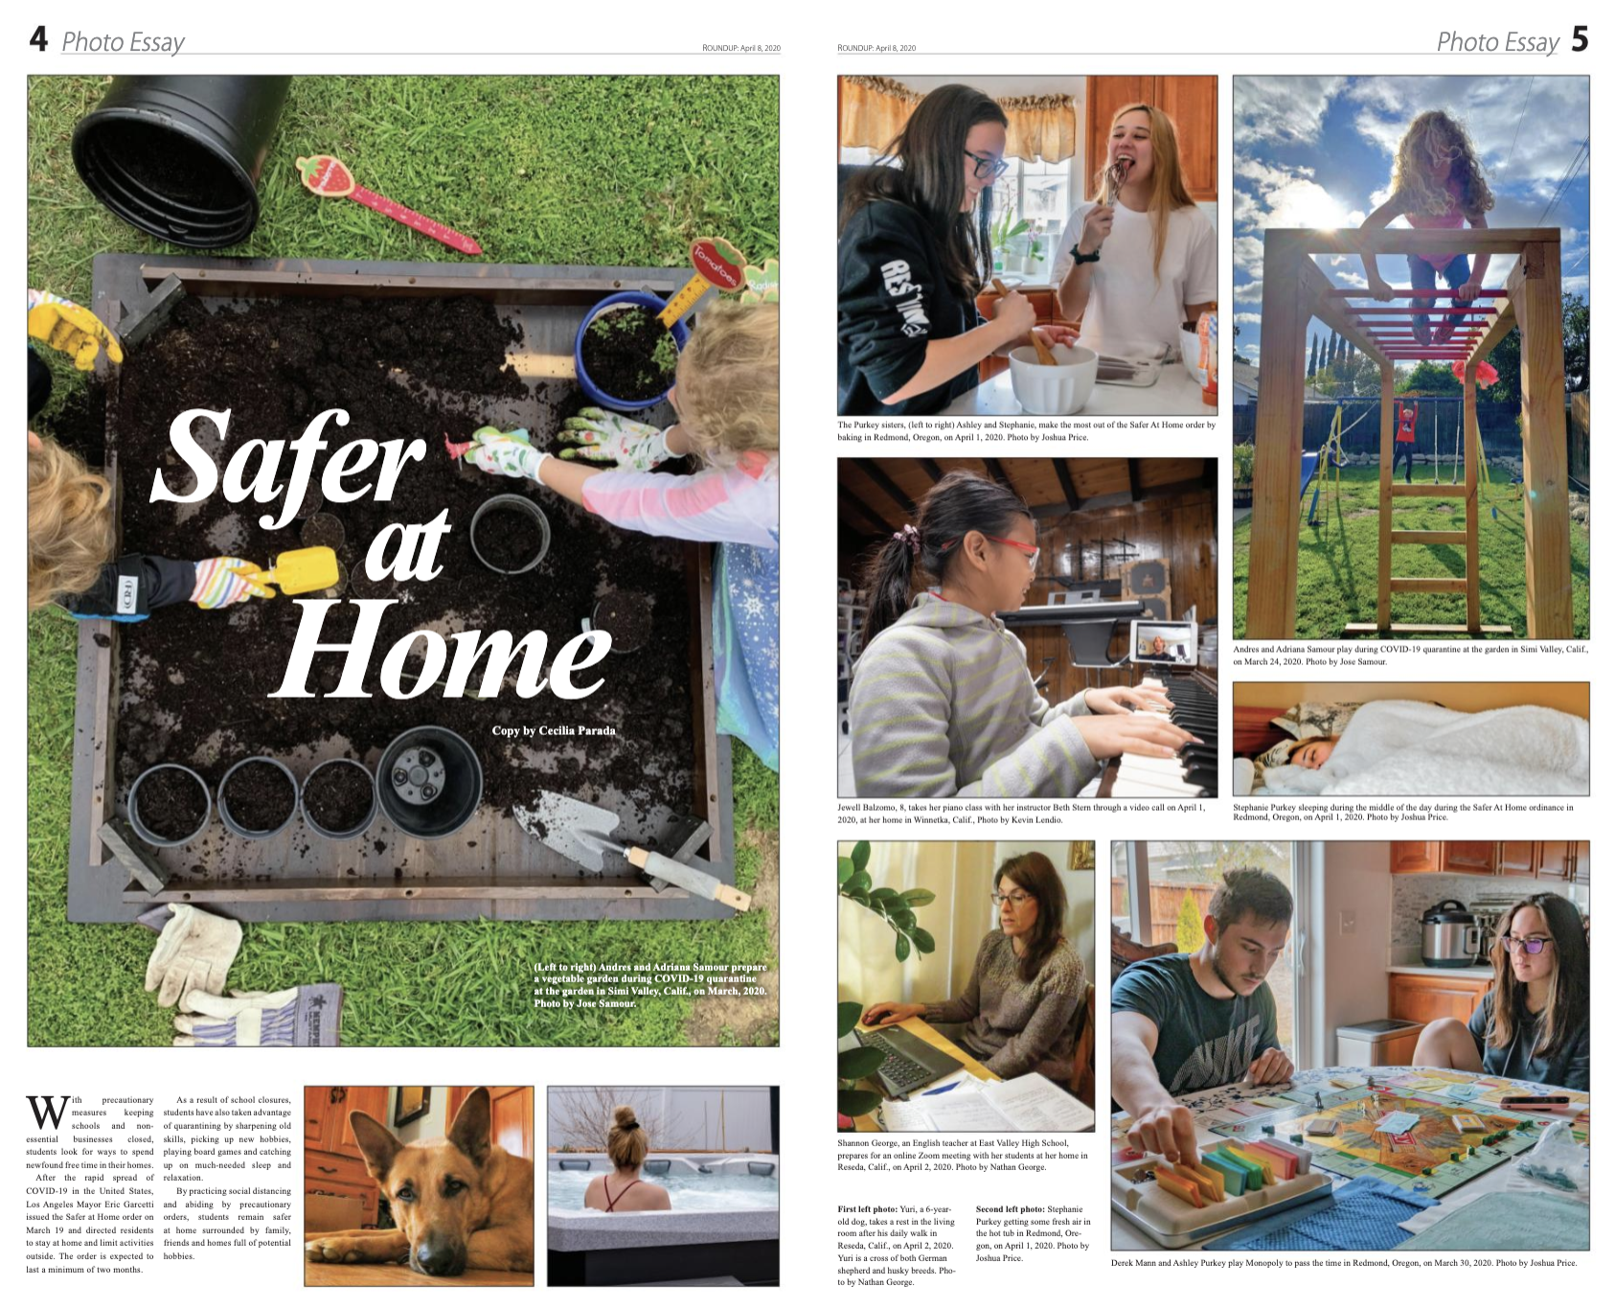
First place
SAFER AT HOME
BY NATHAN GEORGE,
KEVIN LENDIO,
JOSHUA PRICE,
JOSE SAMOUR,

Slide 65
BEST LIVE SHOW

Slide 66
3rd place
ANDREA PENA
AN IMMIGRANT STORY

Slide 67
2nd place
RAFAEL fogoschensul
MILITARY LIFE TALK

Slide 68
First place
WILLIAM ROGERO
TIME MACHINE EXPRESS

Slide 69
BEST PODCAST

Slide 70
HONORABLE MENTION
A SECRET TO SIMPLE MEDITATION
BY WILLIAM ROGERO

Slide 71
3rd place
Sheered
By JASON MELENDEZ

Slide 72
2nd place
VOLUNTEERING
BY MICHELLE REYES

Slide 73
First place
PROFESSOR MARIA PERSER
BY LUIS MENDOZA

Slide 74
BEST RADIO DOC

Slide 75
HONORABLE MENTION
COMICS AND COVID
LUIS MENDOZA

Slide 76
3rd place
THE DISNEY PANDEMIC RESPONSE
LIDIA BECK

Slide 77
2nd place
THE SMALL BUSINESS PANDEMIC RESPONSE
KATIE ROSENDAL

Slide 78
First place
THE MUSIC ABOUT LIFE AND ENDLESS NIGHTS
WILLIAM ROGERO

Slide 79
SPECIAL RECOGNITION

Slide 80
CUB REPORTERS
GISELLE ORMENO AND SHEHREEN KARIM

Slide 81
CUB PHOTOGRAPHER
JOSHUA PRICE and karla avalos

Slide 82
TOP GUN PHOTOGRAPHERS
KATYA CASTILLO AND BEN HANSON

Slide 83
SCHEIBEL AWARD
CHELSEA WESTMAN

Slide 84
MARCONI AWARD
PAULINA VIDANEZ

Slide 85
MVP
PETER VILLAFANE

Slide 86
MOST DEDICATED
KATYA CASTILLO

Slide 87
Media arts awards spring 2020
Amara aguilar, TAYLOR ARTHUR , Sam Bravo, Gregory Favre, Nico Heredia, Jill Leovy, NICK MCNAMARA, megan moureaux, Meg O’Neil, Megan O’Neil, Brian Van der brug
Special Thanks to our Judges!

